Slide 1

Unit 2
Research Paper and Title

Slide 2
Contents
Section A research paper
Section B AIMRD structure
Section C title
Section E excercise

Slide 3

Section A
Research Paper
The following paragraph defines what a research paper is. Underline the most important points in the paragraph.
A research paper is an academic record of new results of an experimental, theoretical or observational scientific research or innovative insights and knowledge on a certain academic subject; or a scientific summary of new progress of a certain known principle applied in practice, which provides a written document for reading, communicating or discussing at an symposium; or for publication in an academic journal; or for other purposes. (From GB7713–87, National Standards of the People’s Republic of China)

Slide 4
Section A
Research Paper
The original Chinese version:
学术论文是某一学术课题在实验性、理论性或观测性上具有新的科学研究成 果或创新见解和知识的科学记录；或是某种已知原理应用于实际中取得新进 展的科学总结，用以提供学术会议上宣读、交流或讨论；或在学术刊物上发 表；或作其他用途的书面文件。《国家标准GB7713–87》

Slide 5
Section A
Research Paper
2. There are many categories to classify the types of research papers. The following mixed diverse types are based on the publication media, reading convenience, and target audience. Go through the terms and make sure you understand each type in academic writing. Which one is a common type that you often read? Besides these, what other types have you found in your own research field?
research article, academic dissertation, scientific thesis, review, communication, rapid report, letter to the editor, paper of empirical research, paper of theoretical research, paper of theoretical application, paper of textual research, paper of technical competence

Slide 6
Section A
Research Paper
According to the written functions and styles, some other kinds are distinguished. Sometimes each of them plays the function only in one section or even a part of the complete paper. Identify the listed types by the following brief description. An argumentative research paper, An informative research paper, An analytical research paper, A persuasive research paper.

Slide 7
Section A
Research Paper
An argumentative research paper
__________________ _ presents two sides on research paper topics and the writer assumes a position and presents facts and authoritative opinions to defend his/her side for the purpose to convince readers.
2) ___________________ allows the writer to have an opportunity to convince or influence his targeted readers. It usually leaves no chances for readers to ask further questions.
A persuasive research paper

Slide 8
Section A
Research Paper
3) ___________________, essentially a sub-type of an informative research paper, is a type of paper that presents information on the topic. However, instead of merely presenting the information, the writer must be able to conduct factual analysis of the data to evaluate his research materials in an unbiased manner.
4) ___________________ reports new information on a certain topic. Data on this type of study may also be used to prove or disprove an existing concept, so that it should offer readers sufficient information on the topic. Analysis and comparison are certainly applied.
An analytical research paper
An informative research paper

Slide 9
Section A
Research Paper
3. From Exercises 1 and 2 we may have been aware of two main components in a research paper writing: research quality and writing skills. Look at the words and phrases in the list below and classify them into research quality and writing skills of a research paper.
correct grammar 2) formal style 3) creativity
4) complex sentences 5) standardization 6) originality
7) repeatability 8)sufficient evidence
9) academic significance 10) accurate expressions
11) Academic property 12)logical development of meaning 13) correct journal format 14) convincing and valid
15) complete, concise, clear and coherent

Slide 10
Section A
Research Paper
4. To have a further understanding of a research paper and to distinguish it from other styles of writing, mark the items below which are unique to research papers.
It is a work that shows your innovation.
It is a summary of another article or a book (or other source material).
3) It synthesizes your discoveries about a research project and your judgment, interpretation, and evaluation of those discoveries and is presented according to a required format by a journal.

Slide 11
Section A
Research Paper
4) It acknowledges all sources you have used.
5) It repeats tentatively the ideas of others.
6) It does not substantiate personal opinion.
7) It skillfully puts together a series of quotations.
8) It shows that you are part of a community of scholars. 9) It copies or accepts another person’s work without acknowledging it, whether the work is published or unpublished, professional or amateur.

Slide 12
Section A
Research Paper
5. Forming a hypothesis is a key step for an original research paper. Have you ever heard of the famous quotation made by Hu Shi ( 胡 适，Methods and Materials in Scholarly Research［《治学的方法 与材料》］, 1928)? It has involved many debates on the point of “to hypothesize boldly” for many years. Discuss the translated citations and give comments on them with your partners: Do you think to establish “bold hypothesis” is a good quality of a scientist?

Slide 13
Section A
Research Paper
Hu Shi (胡适): Scientific methods are in fact very simple, no more than respecting facts and evidence. As in application, the methods involve hypothesizing a point boldly and verifying it discreetly (大胆假设，小心求证).
Lin Minsheng (林敏生, former professor of Wisconsin University): Although bold hypothesis emphasizes the sceptic spirit in research, it is essentially a competent hypothesis. It is not the fact that the more bold, the better, since scientific hypothesis could be true or false.

Slide 14
Section A
Research Paper
6. A research proposal (in Chinese 开题报告 or 选题报告 ) is often required by discipline thesis/dissertation committee or entity before research project practice. It should convince others that you have a worthwhile research project and that you have the competence and the work-plan to complete it. Generally, a research proposal should contain all the key elements involved in the research process and include sufficient information for the readers to evaluate the proposed study. Tick the necessary elements that are contained in a research proposal.

Slide 15
Section A
Research Paper
To address what you plan to accomplish and why you want to do it and how you are going to do it.
To provide sufficient information to convince your readers that you have an important research idea.
To focus on the development of research ideas.
To show that you have a good grasp of the relevant literature and the major issues.
To firmly persuade the sponsor for financial support.
To indicate that your methodology is sound.
To tell the discipline thesis committee that your supervisor agrees to continue the project.
To demonstrate that your writing is coherent, clear and compelling.

Slide 16
Section A
Research Paper
7. To be more specific, try to match the headings in a proposal with their brief description:
background information
unsolved problems
hypothesis/opinion
aims
approaches
conclusion

Slide 17
Section A
Research Paper
Based on the background information, the researcher makes a thorough and penetrating analysis to find out the unsolved problems and evaluates the significance, i.e. to determine what will be original and creative.
The researcher decides his/her study work with the aim of solving some locally or universally practical or theoretical problems and making sure that these problems have not been addressed in previous academic research.
With a reasonable hypothesis and a reliable research plan, a possible conclusion may be predicted, but it is important to understand that your actual results cannot be determined ahead of time.

Slide 18
Section A
Research Paper
4) Determining your approach is one of the most vital steps in your work. All of the details in the process must be thoughtfully contemplated and considered. Possible difficulties must be anticipated along with feasible solutions to ensure smooth execution.
5) The researcher establishes a hypothesis which is believed to explain his/her observations. This hypothesis must be testable and must account for all possible data collected.
6) A researcher should have an overall understanding of the work that has been done in his/her relevant field.

Slide 19
Section A
Research Paper
8. To be scientific, certain steps must be carried out in an orderly way during your research. What is the general process of research within your own specialty? With a partner discuss your own process. Then organize the following steps into a proper order and discuss any different steps from yours.
Prepare equipment/materials/subjects.
Read as many relevant and current references as possible.
Select software for data analysis.
Collect data during experiment.
Analyze and organize results systematically in texts and diagrams.

Slide 20
Section A
Research Paper
6) Suggest your own hypothesis/solution.
7) Design research method/approach.
8) Generalize the results and draw definite/tentative conclusions.
9) Find out problems/limitations/contradictions/possible further research work from previous research.
10) Point out your research purposes.
11) Explain certain/possible reasons observed in experiments.
12) Compare and contrast previous research with yours.
13) Answer the hypothesis and research aim.
14) Point out limitations and recommend future research direction.

Slide 21
Read as many relevant and current references as possible.
Find out problems/limitations/contradictions/possible further research work from previous research.
Suggest your own hypothesis/solution.
Point out your research purposes.
Design research method/approach.
Prepare equipment/materials/subjects.
Select software for data analysis.
Collect data during experiment.
Analyze and organize results systematically in texts and diagrams.
Explain certain/possible reasons observed in experiments.
Generalize the results and draw definite/tentative conclusions.
Compare and contrast previous research with yours.
Answer the hypothesis and research aim.
Point out limitations and recommend future research direction.

Slide 22

Section B AIMRD Structure
Research papers are generally organized following the format of AIMRD, which is widely accepted in the international scientific world. What does each initial stand for? Why is a scientific paper organized in that particular way?
A:__________ I:__________ M:__________ R:__________ D:__________
Now read the quotation in the following block which is extracted from pp. 2–3, Macmillan English Dictionary for Advanced Learners to see whether your answer is correct and what is not included in the format.
The research paper reports original research, almost always in the standard format of Abstract, Introduction, Materials and Methods, Results, Discussion and Literature Cited.

Slide 23
Section B AIMRD Structure
2. This time match the brief description of each section in Column B with its subheading in Column A. To be convenient in learning, the sections of Discussion and Conclusion are treated as one section of Discussion.
A | B
1. Abstract | a. What have been achieved and what has/have remained unsolved → hypothesis and research purpose.
2. Introduction | b. Data observed, collected, compared and contrasted.
3. Materials and Methods | c. Explanation of possible reasons, generalization of rules, consistency with previous research, limitations, suggested future direction.
4. Results | d. Materials/equipments/subjects, methodology, data analysis, software and approach.
5. Discussion | e. The most important points in a paper.
e
a
d
b
c

Slide 24
Section B AIMRD Structure
3. The diagram shows the ranges of information in different sections of a paper. Identify each part of the diagram by filling A, I, M, R, D respectively and then think about:
1) Which section involves the points of view of other researchers? 2) Which section newly generalizes points for universal sharing? 3) Which section focuses on the individual research work?
(Weissberg & Buker, 1990: 186, revised by Cargill & O’Connor, 2009:10)
A
I
M
R
D

Slide 25
Section B AIMRD Structure
4. Have a quick glance at your own three papers and mark the AIMRD sections to fill in the table below. You may find different subheadings that carry the same meanings, so that put the different subheadings into categories in the table below. An example has been done for you in the first row. Then swap yours with that of your partner’s to find out more alternatives.
Discuss: Why do you think they are different?

Slide 26
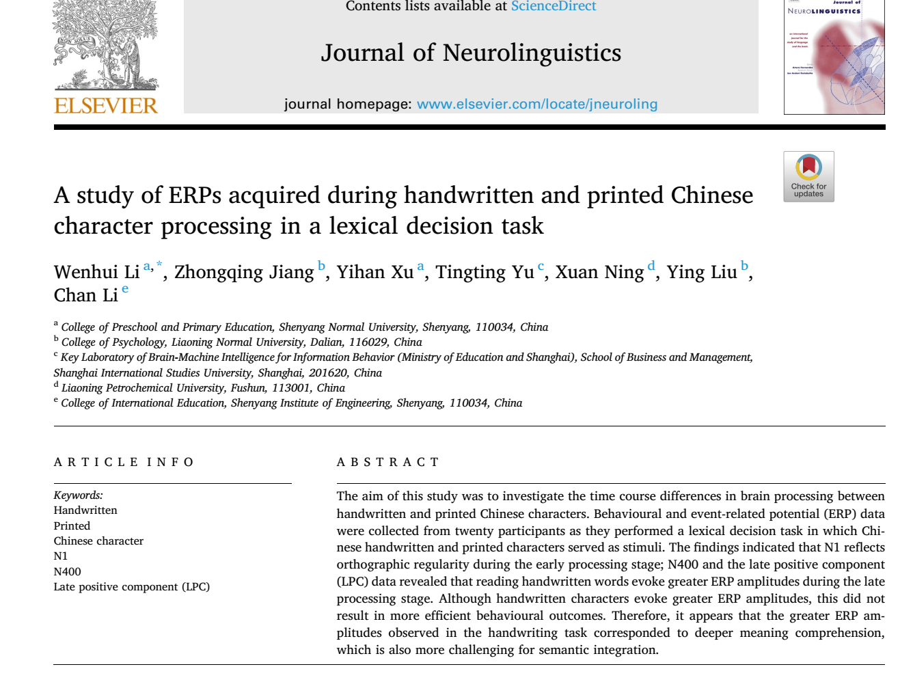

Slide 27
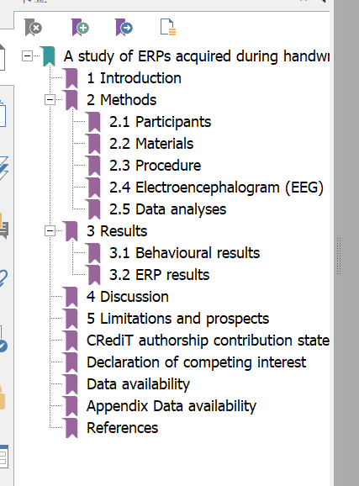

Slide 28
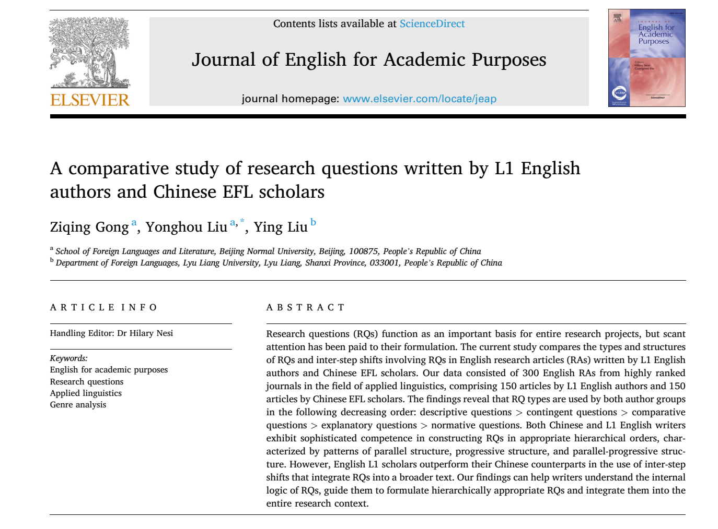

Slide 29
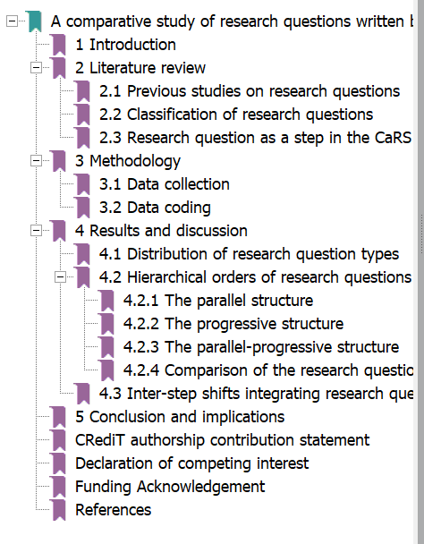

Slide 30
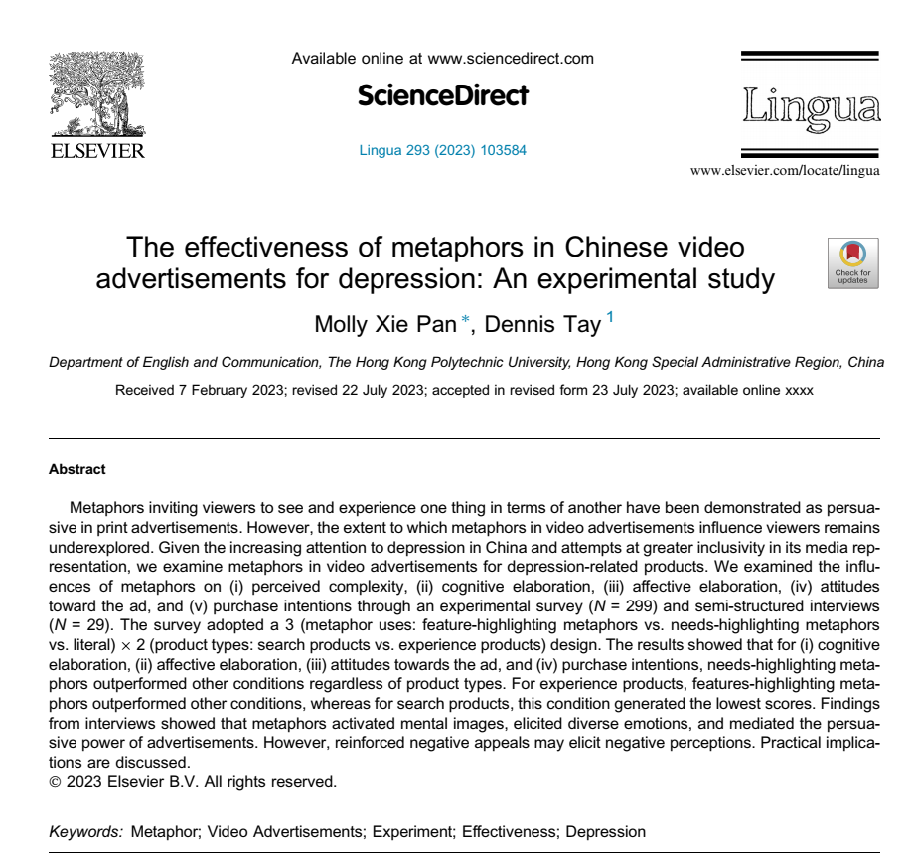

Slide 31
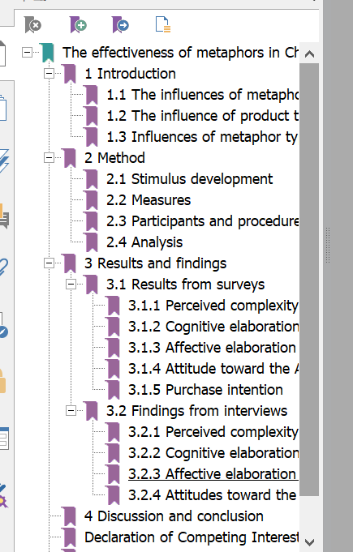

Slide 32
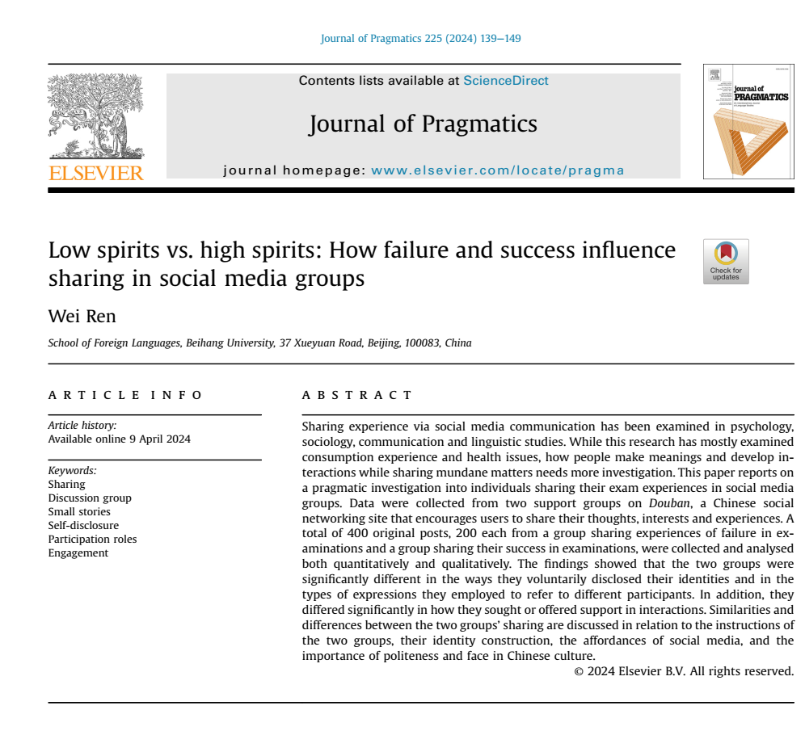

Slide 33
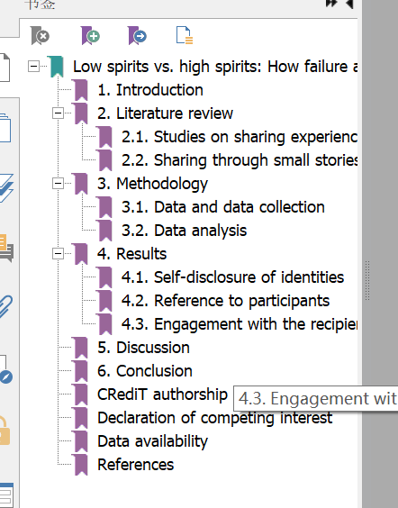

Slide 34
Section B AIMRD Structure
5. Try to suggest some variations for Weissberg & Buker’s model (Ex.3) by dividing the sections (drawing lines) based on your own papers.

Slide 35


Slide 36







Slide 37
Section B AIMRD Structure
7. Discuss the following case with your partner and answer this question.
Can you submit your paper to another journal without any revision after the paper has been rejected by one journal? Why?
The Case
You wrote a paper which you submitted to a well-respected academic journal. It took you a painstakingly long time to study its editing requirements and linguistic features. Unfortunately, the paper was not accepted. You are confident that the paper is of great academic value, so you have decided to submit it to another journal.

Slide 38
Section B AIMRD Structure
8. Summarize the principles of how to organize the sections of a research paper.

Slide 39

Section C Title
The List of Titles will be used in the section to avoid repeated printing.
1) A corpus-based comparison study of first-person pronoun we in English-language abstracts
2) Musical pitch processing predicts reading development in Chinese school-age children
3) A comparison of learning and retention of a syntactic construction between Cantonese-speaking children with and without DLD in a priming task
4) Tracking the development of logical metaphor usage in argumentative writing: A longitudinal study with EFL learners

Slide 40
Section C Title
5) A dynamic metaphor perspective on Trump and Xi’s trade negotiation in governmental discourse
6) Stative verbs and perceptions of intensity: The case of ‘believe’ in simple and progressive aspect
7) Is corrective feedback during telecollaboration beneficial? The effects of peer and teacher corrections on L2 writing proficiency
8) Low spirits vs. high spirits: How failure and success influence
sharing in social media groups

Slide 41
Section C Title
9) The effectiveness of metaphors in Chinese video advertisements for depression: An experimental study
10) Nativeness perceptions and speaker voice as predictors of (non-)native English speaker evaluations in four ELF contexts
11) War in law: A corpus linguistic study of the lexical item war in the laws of war
12) A study of ERPs acquired during handwritten and printed Chinese character processing in a lexical decision task

Slide 42
Section C Title
13) Event-Frames Affect Blame Assignment and Perception of Aggression in Discourse on Political Protests: An Experimental Case Study in Critical Discourse Analysis
14) Objectification strategies outperform subjectification
strategies in military interventionist discourses
15) A comparative study of research questions written by L1 English authors and Chinese EFL scholars
16) Trust-building strategies in corporate discourse: An experimental study

Slide 43
Section C Title
What general functions does a title play? Indicate which of the following phrases are possibly and necessarily relevant to title construction:
To be poetic and literary so that everybody is interested in it.
To show the most important achievement(s) in the research.
To tell the story involved in the research process.
To convey key information for the readers of the same field.
To express thanks to those who have given great help academically, financially, or personally.
To create a sensational effect for the readers.
To indicate both the specific study and the general research field.
To illustrate the unique research methodology.
To report the location, period of time, and subjects of the experiment.
To highlight the significant purpose of the work.
To manifest the original nature of the paper.
To express all the points as concisely and sufficiently as possible.

Slide 44
Section C Title
1) colon (:)—Backpacker tourism: sustainable and purposeful? : to indicate the two parts in a title. But be careful: In a Chinese title, a dash (破折号“— ”) plays the same function.
2) hyphen (-)—agroforestry-based
3) slant (/)—(infant/toddler); maize/sesbania intercrops: to separate words of the same kind so the word “and” is omitted and they are regarded as one word in a title.

Slide 45
Section C Title
4) comma (,)—East Java, Indonesia; (creating identities, building trust, and sharing knowledge) 5) brackets ( ( ) )—plantation system of kayu putih (Melaleuca leucadendron LINN), poplars (Populus spp.): Generally brackets are not used in a title, but they are used when the italic Latin term of a species is indicated after its English name for scientific preciseness.
6) question (?) sustainable and purposeful?

Slide 46
Section C Title
8. Some editing features in a title should be noticed sensitively when you submit your paper to a journal. Find an example of each of the following items in the listed titles:
Capital letters in different ways:
— All the letters: Title ____________________________
— Only the initial letter of the title: Title _____________
— All the content words: Title _____________________
— Specific terminology: Title ______________________
Italics (usually a Latin term in biology related sciences): Title__________________________________________
Abbreviation:
Title __________________________________________

Slide 47
Section C Title
9. What do you know about the length of a title? Look at the following Investigation and interpret the table. Then answer the questions:
Which title is longer: an English one or a Chinese one?
Do you agree with the research conclusion that a shorter title among the same type of research programs enjoys greater citation? Your possible reason?

Slide 48
Section C Title
10. It is investigated by a Chinese linguist that the high frequency prepositions in English papers published by Chinese scientists include of (8.7%), in (3.6%), on (3.1%), with (2.3%), and for (1.8%). Please complete the following titles with the given prepositions when referring to the Chinese counterparts.
among
and
at
for
In
on
or
to
of

Slide 49
Section C Title
to
An Integrative Approach ________ Vocabulary Teaching (中学英语词汇综合教 学法)
Attention ________ Vocabulary Development ________ Reading: Quantity and Quality (注重阅读中的词汇教学：数量与质量)
Integration ________ Traditional Chinese Writing ________ Progress Writing Approaches ________ Teaching EFL Writing (结合传统汉语写作，促进英语 写作教学)
Teaching ________ Testing: Some Considerations ________ Teaching Listening ________ Non-English Majors ________ the College Level (考试还是教学：中 国非英语专业大学生听力教学的一些思考)
A Comparative Study ________ the Curriculums ________ BA Programs ________ Business ________ China (高校商务英语专业本科课程设置对比 分析)
Face to face classroom learning activities are transformed into online communication ________ the result of significantly increasing innovative and social benefits (面对面课堂学习活动转变为线上交际，带来的结果是日益增 强的创新性和社会性的效果)
to
in
of
and
in
or
on
for
at
among
for
in
of
with

Slide 50
Summary
Section A
References play an essential role in any academic paper of good quality, with their format varying with the requirements of specific academic journals.
Generally we have different labels for the part of the References section with the responding format for each style, such as MLA and APA.
With regard to a certain reference item, some components are compulsory, while others are optional.

Slide 51
Summary
Section B
Arrangement of names constitutes an important part in the work of reference. We should bear in mind the differences of Chinese names and the foreign ones, i.e. their components, their order, etc.
Differences in a reference with one author, two authors, and more than three (including three) authors are a bit complex, since some abbreviations and symbols are employed.

Slide 52
Summary
Section C
The format and arrangement are tricky and call for a careful processing. References shall be arranged alphabetically in terms of the authors’ surnames (both so for Chinese names and for others).
There is a relatively fixed order to arrange each component of the reference according to the requirements of various academic journals.
The format will differ depending on whether the paper appears in a journal, in an edited book or in a proceeding. Some alternatives shall also be made in accordance with the form of a reference, say, whether it is a monograph, a proceeding, an item from the Internet, an unpublished thesis or dissertation, etc.

Slide 53

Section E Formal Style
When we write a research paper, we have to strictly adopt the correct academic style. According to Oxford Learner’s Dictionary of Academic English, style is “the correct use of language”, while it is defined as “correct writing”, i.e. “a way of using words or spelling that is considered correct” by Longman Dictionary of Contemporary English. A “correct” style contains many elements from text structure to sentence pattern and word choice. We have to learn the rules and acquire the actual use by reading sensitively.

Slide 54

Section E Formal Style
Read and contrast the different styles of a description of the structure and function of a Lock-Lock drinking bottle written by two students.

Slide 55
Section E Formal Style
Text 1
I bought a Lock-Lock drinking bottle and it is my favorite one because it is light, convenient and lovely. I carry it with me to have the whole day classes and evening self study. Now I’d like to tell you its advantages. First, it is light. It is made of a kind of special plastic, not porcelain or stone. It is also convenient in two ways: 1) It can be safely taken with me because the lid is tightly closed to the body without any water leaking. 2) It is easy for me to drink. Whenever you pour in water (of course you can put in any kind of beverage) and lock it, what you are going to do when you want to drink is simply open the small lid on the top! Last but not the least, it is lovely. It is transparent so you can see through the inside water. It has several colors so you can choose the one you like best. What a nice bottle! Do you like it?

Slide 56
Section E Formal Style
Text 2
The Lock-Lock drinking bottle is used to hold liquids, which mainly consists of a cylindrical bottle body and a bottle cover. Both are made of a kind of translucent plastic called silicone resin, which has a certain degree of corrosion and high temperature resistance, enabling the bottle to contain hot tea or soft drink. On the rim of the bottle, four pegs are projected from the bottle wall at equal intervals, corresponding to the position of the four buckles fixed to the rim of the cover to Unit 2 Research Paper and Title 47 keep the bottle body tightly locked and prevent water from leakage. Besides, a ring is placed in the middle of the buckles, and tied with a green lanyard, similar in color to the cover for convenient carrying. On the top of the cover a drinking hole covered with a small lip is set, which allows its user to drink water without opening the entire cover.

Slide 57
homework AIMRD Structure
Appendix | Abstract | Introduction | Materials & Methods | Results | Discussion
1
2
3
4
5
6
7

Slide 58
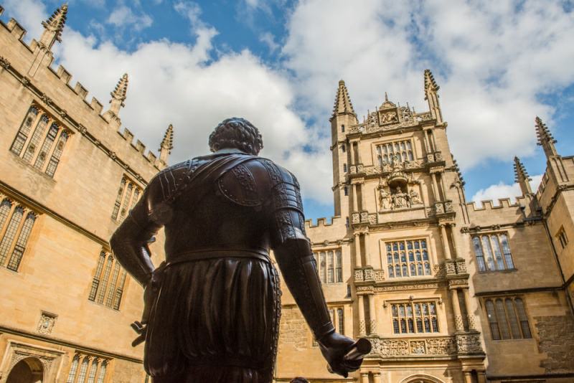
Thank You

